Slide 1


Slide 2

Grades
We will finish grading all of your homework and email your grades this weekend
Our final grading scheme:
Attendance (20 pts)
-5 pts for each unexcused absence
Homework (20 pts)
Group Project (30 pts)
Final Individual Project (30 pts)
If (your_score > 70) { return P } else { return NP }

Slide 3
Future Lectures (Design)
Lecture 8: Responsive Design
Lecture 9: User Interface Elements
Lecture 10: Extra Topic
We will open up for a poll for the topic of Lecture 11
Lecture 11: Final Project Presentation

Slide 4
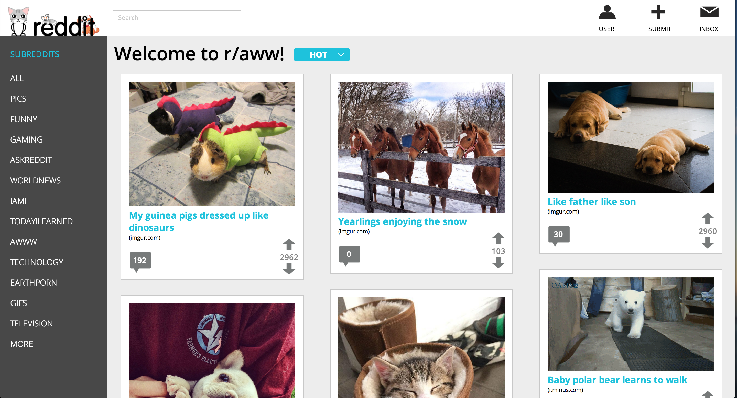
Group Project Award: Best User Experience

Slide 5
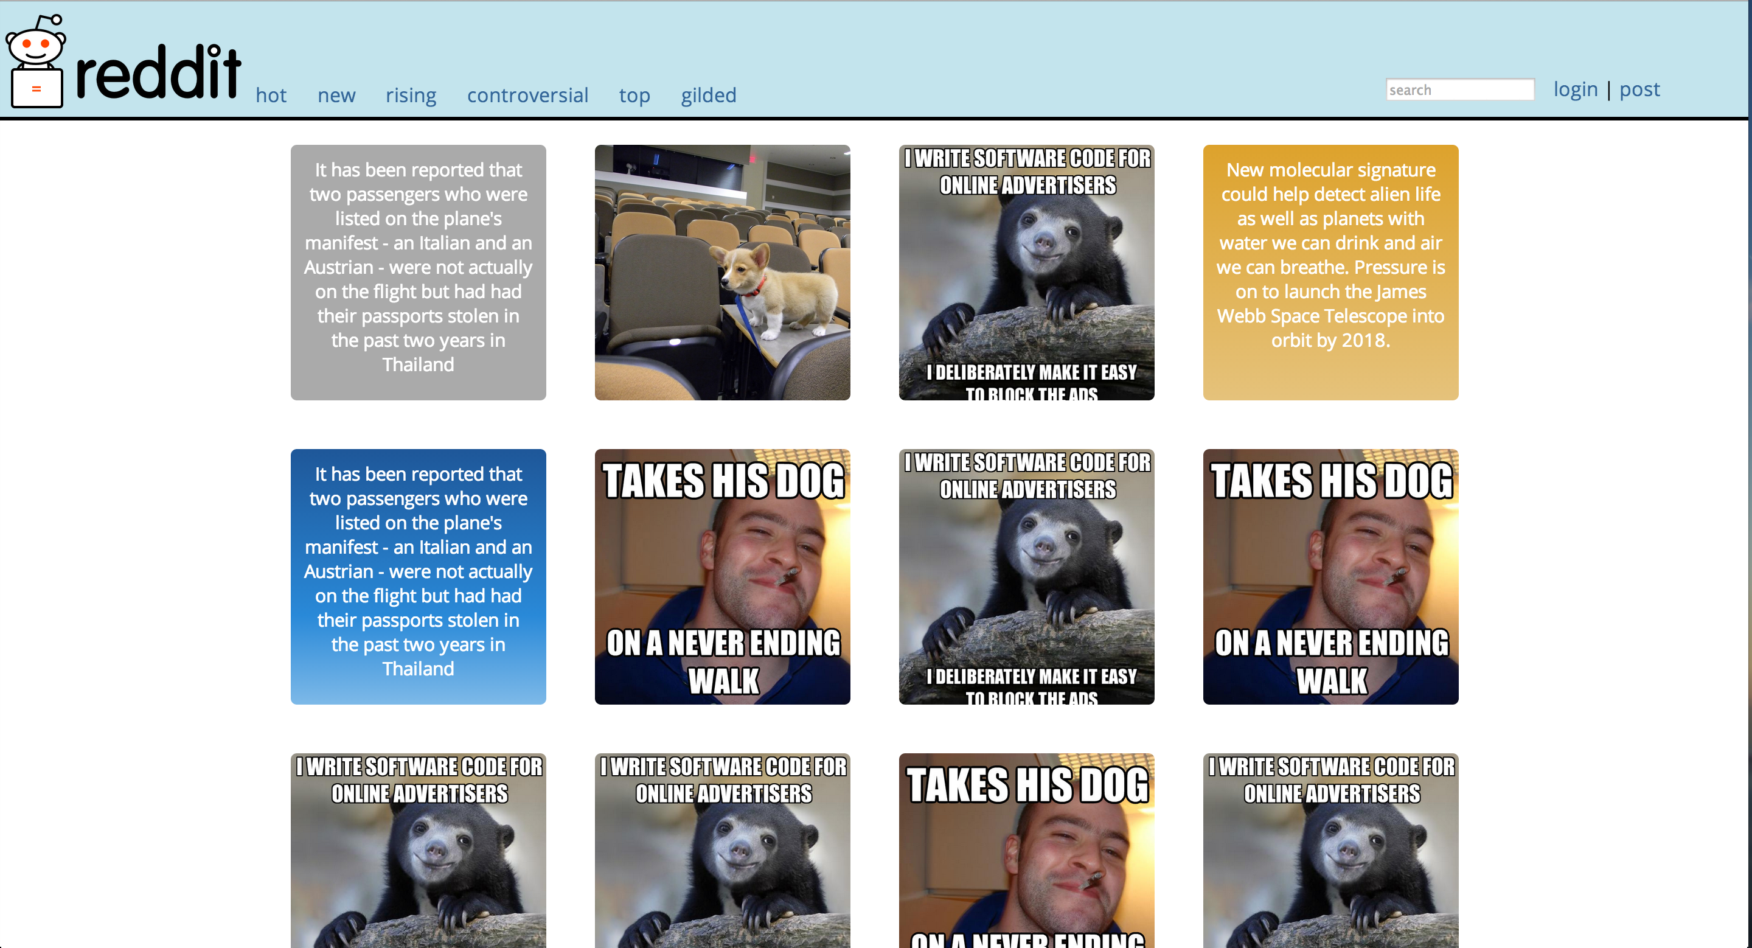
Group Project Award: Best Aesthetics

Slide 6
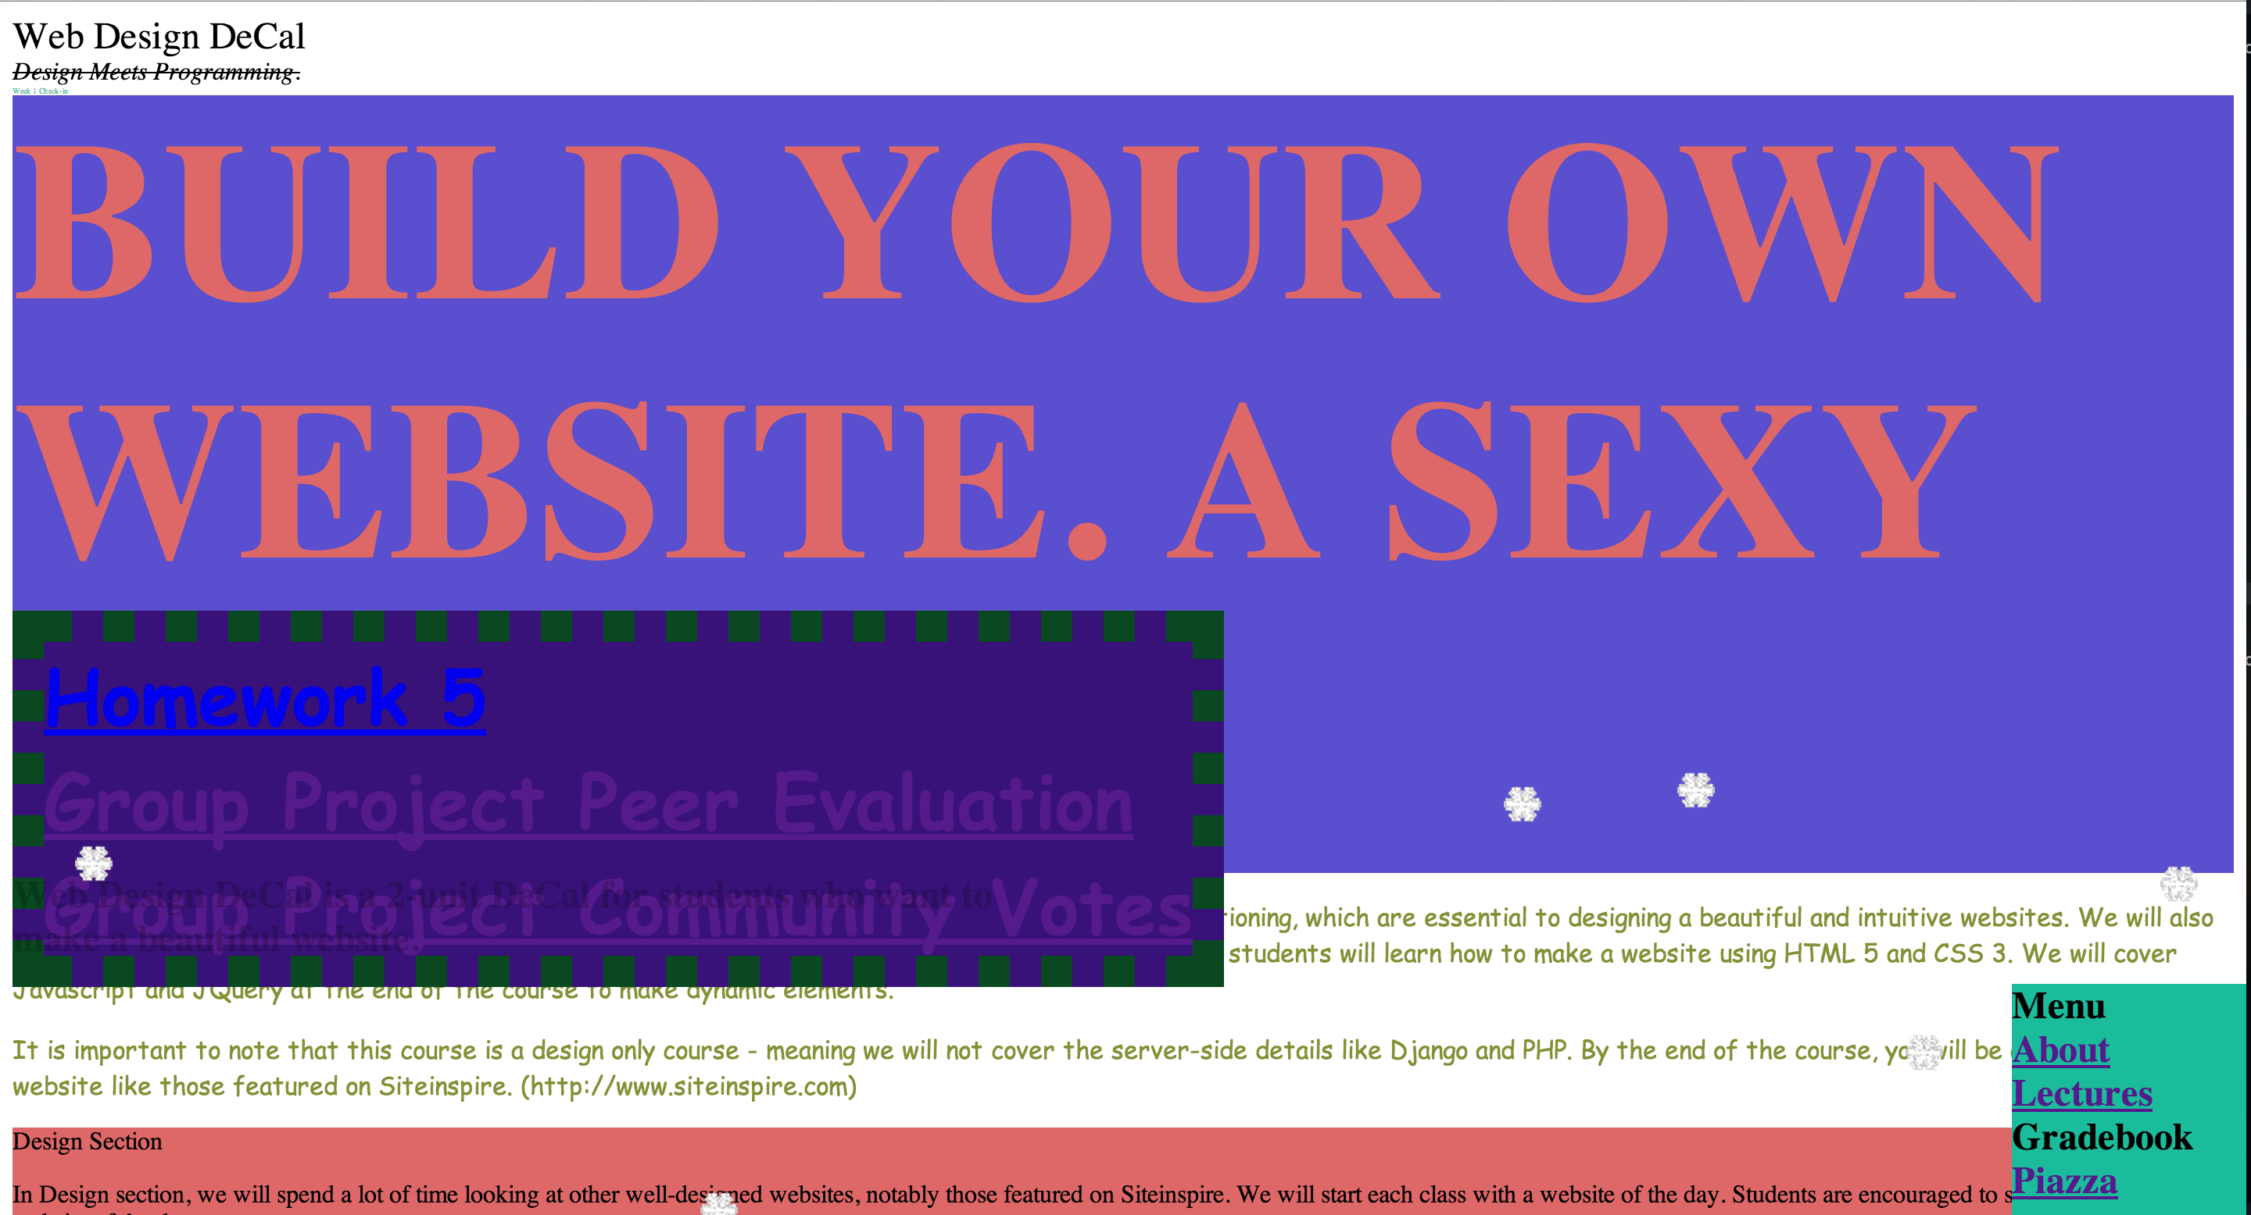
Introducing the new course website

Slide 7
Final Project
Topic of your own
Personal Website
Web Application (Potential Startups?)
Redesign of an Existing Application (Reddit?)
You are required to include some Javascript/Jquery functionality
Features that require back-end implementation (ex. Search) are not necessary and can leave as a mockup
Due Date: May 1st (Last Day of Class)
Details of the project specs will be released at the end of this week!

Slide 8

Four pillars for Emphasis
Emphasis
Spacing
Positioning
Typography
Color

Slide 9
Today
8 Tips for User Experience

Slide 10
User Experience
UI is more than just an interface aesthetics
Needs to take into account the experience that user goes through
Remember: The purpose of design is to bring order to compelxity
NOT creating artwork
IS creating an “intuitive” experience that makes complex features easier to use

Slide 11
1. Keep things consistent
Your website should have a consistent theme resonating throughout the entire site.
You should have a consistent…
Placement of modules (Top bar, search box, etc.)
Color (Don’t use more than three color schemes)
Font (Don’t use more than two fonts)
UI Pattern (If you are going to do flat, do it all-out flat)

Slide 12
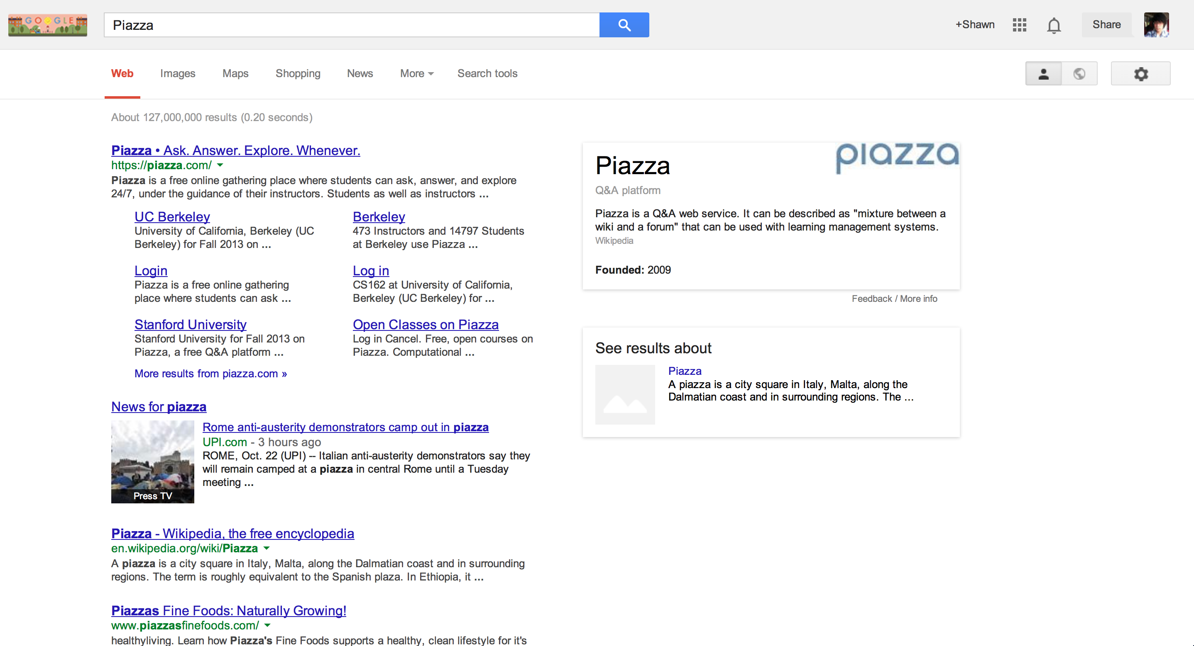
Consistency: Google

Slide 13
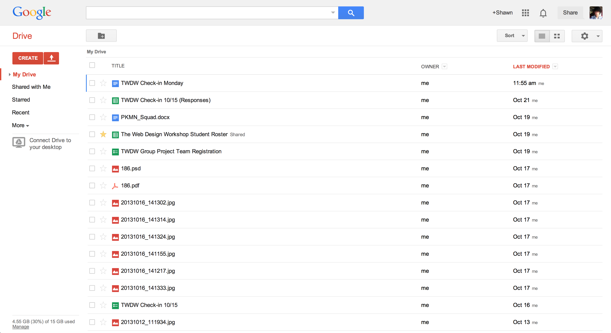
Consistency: Google

Slide 14
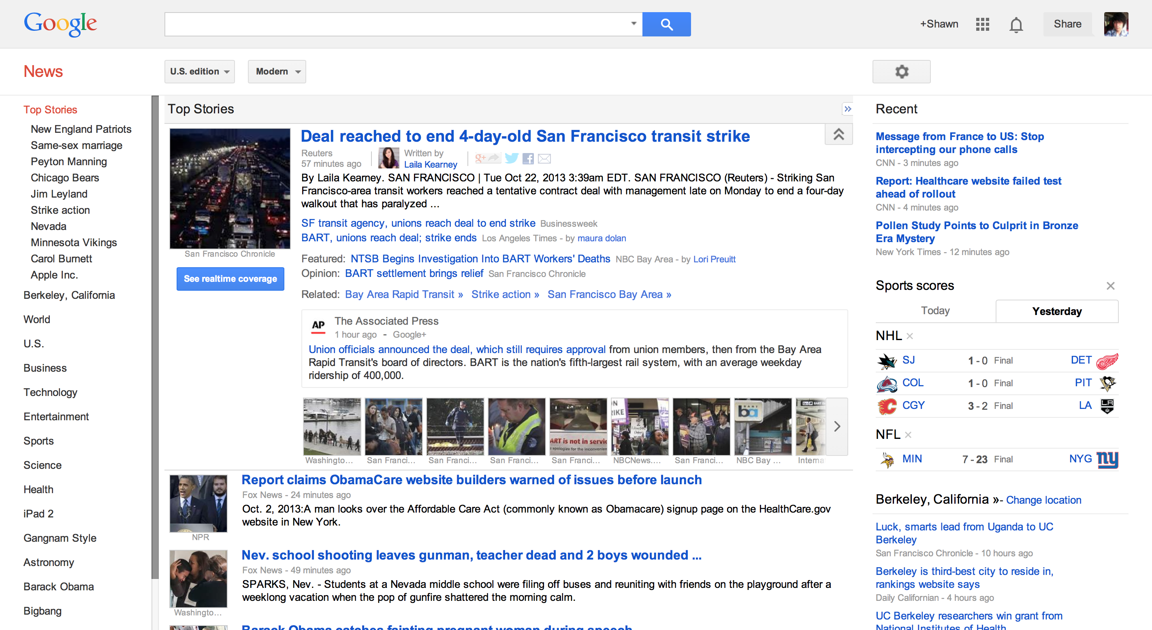
Consistency: Google

Slide 15
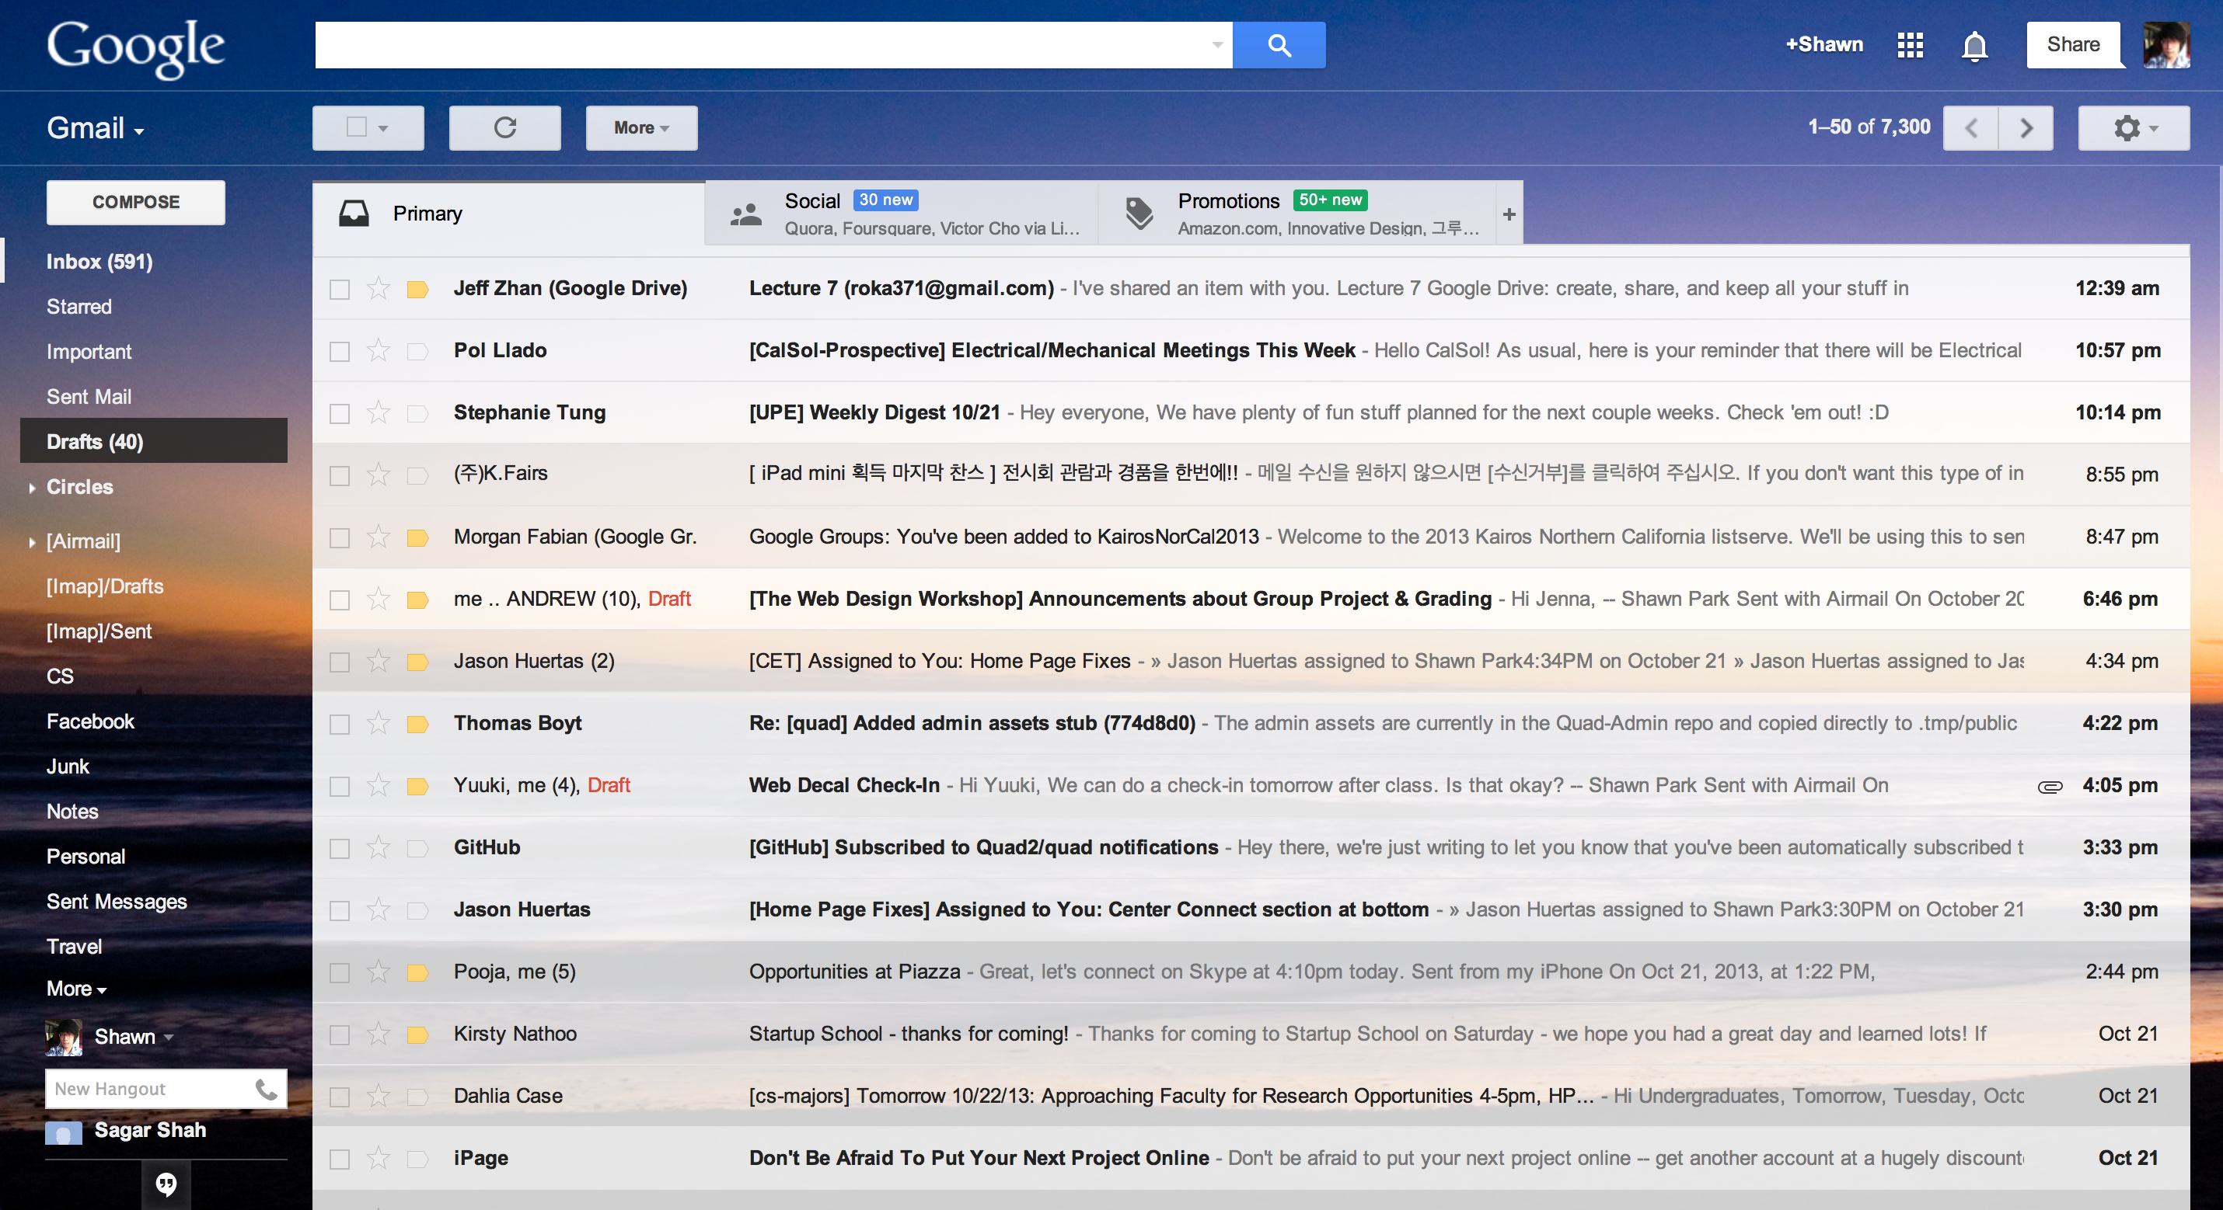
Consistency: Google

Slide 16
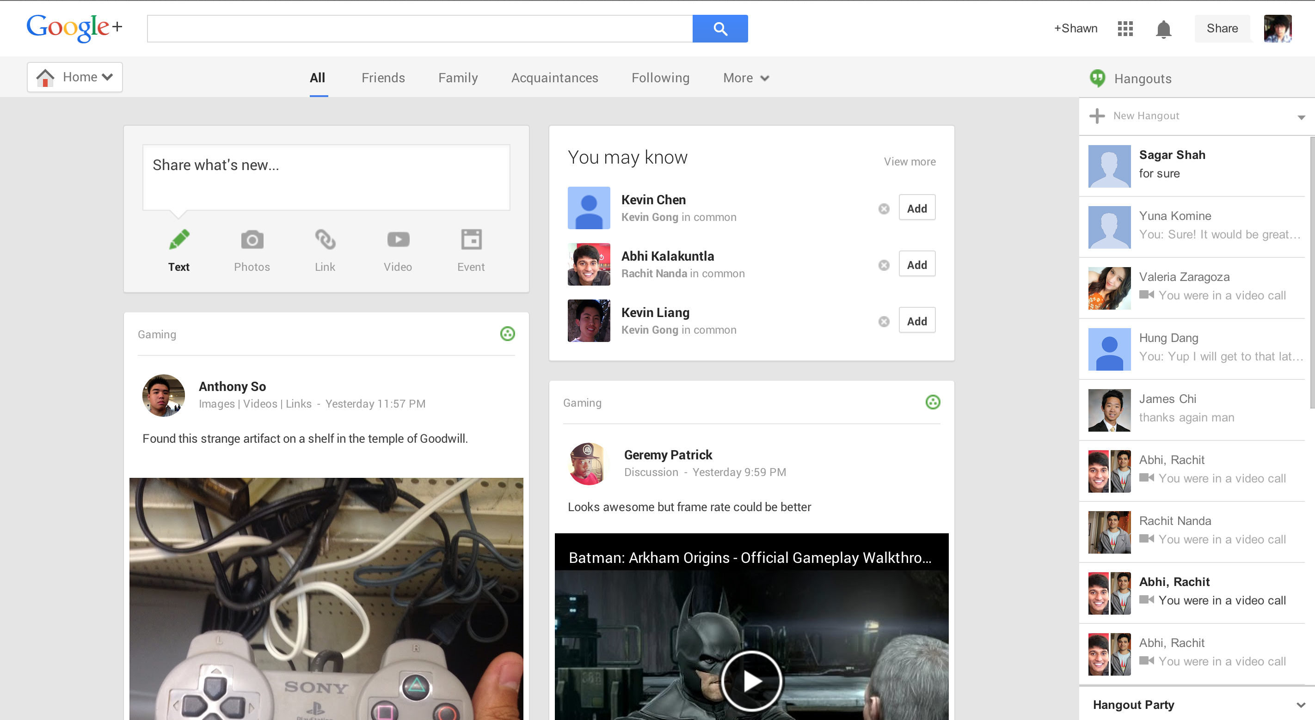
Consistency: Google

Slide 17
2. Content is the King
Direct the user’s attention to the content (eventually)
In most cases, content should have the biggest screen estate
Try to reserve at least 70 – 80% of the screen estate for your content
Too many “position: fixed” elements ruin this!
Example: (Old) Google Reader

Slide 18
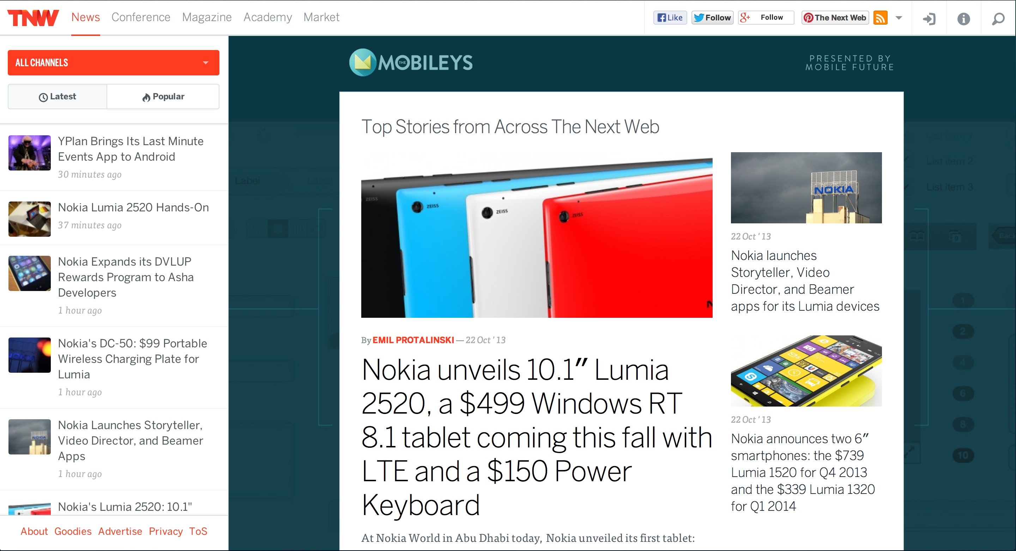
Ample screen estate for content: TNW

Slide 19
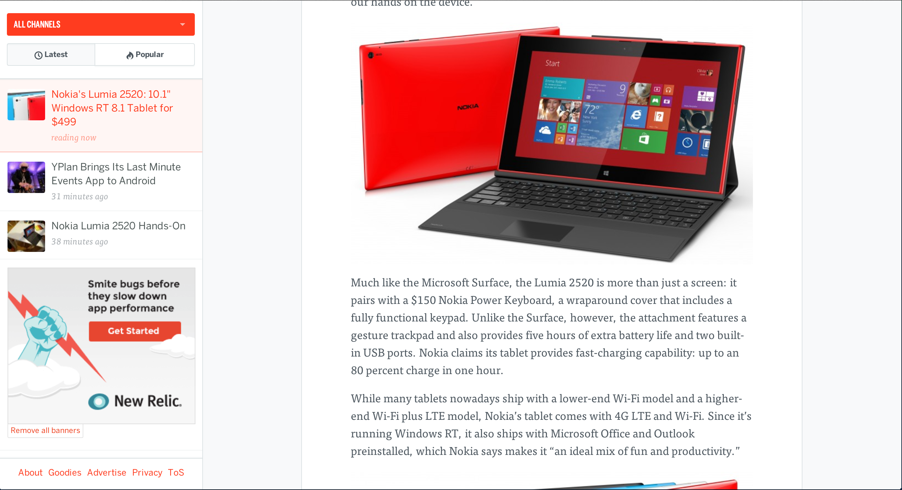
Ample screen estate for content: TNW

Slide 20
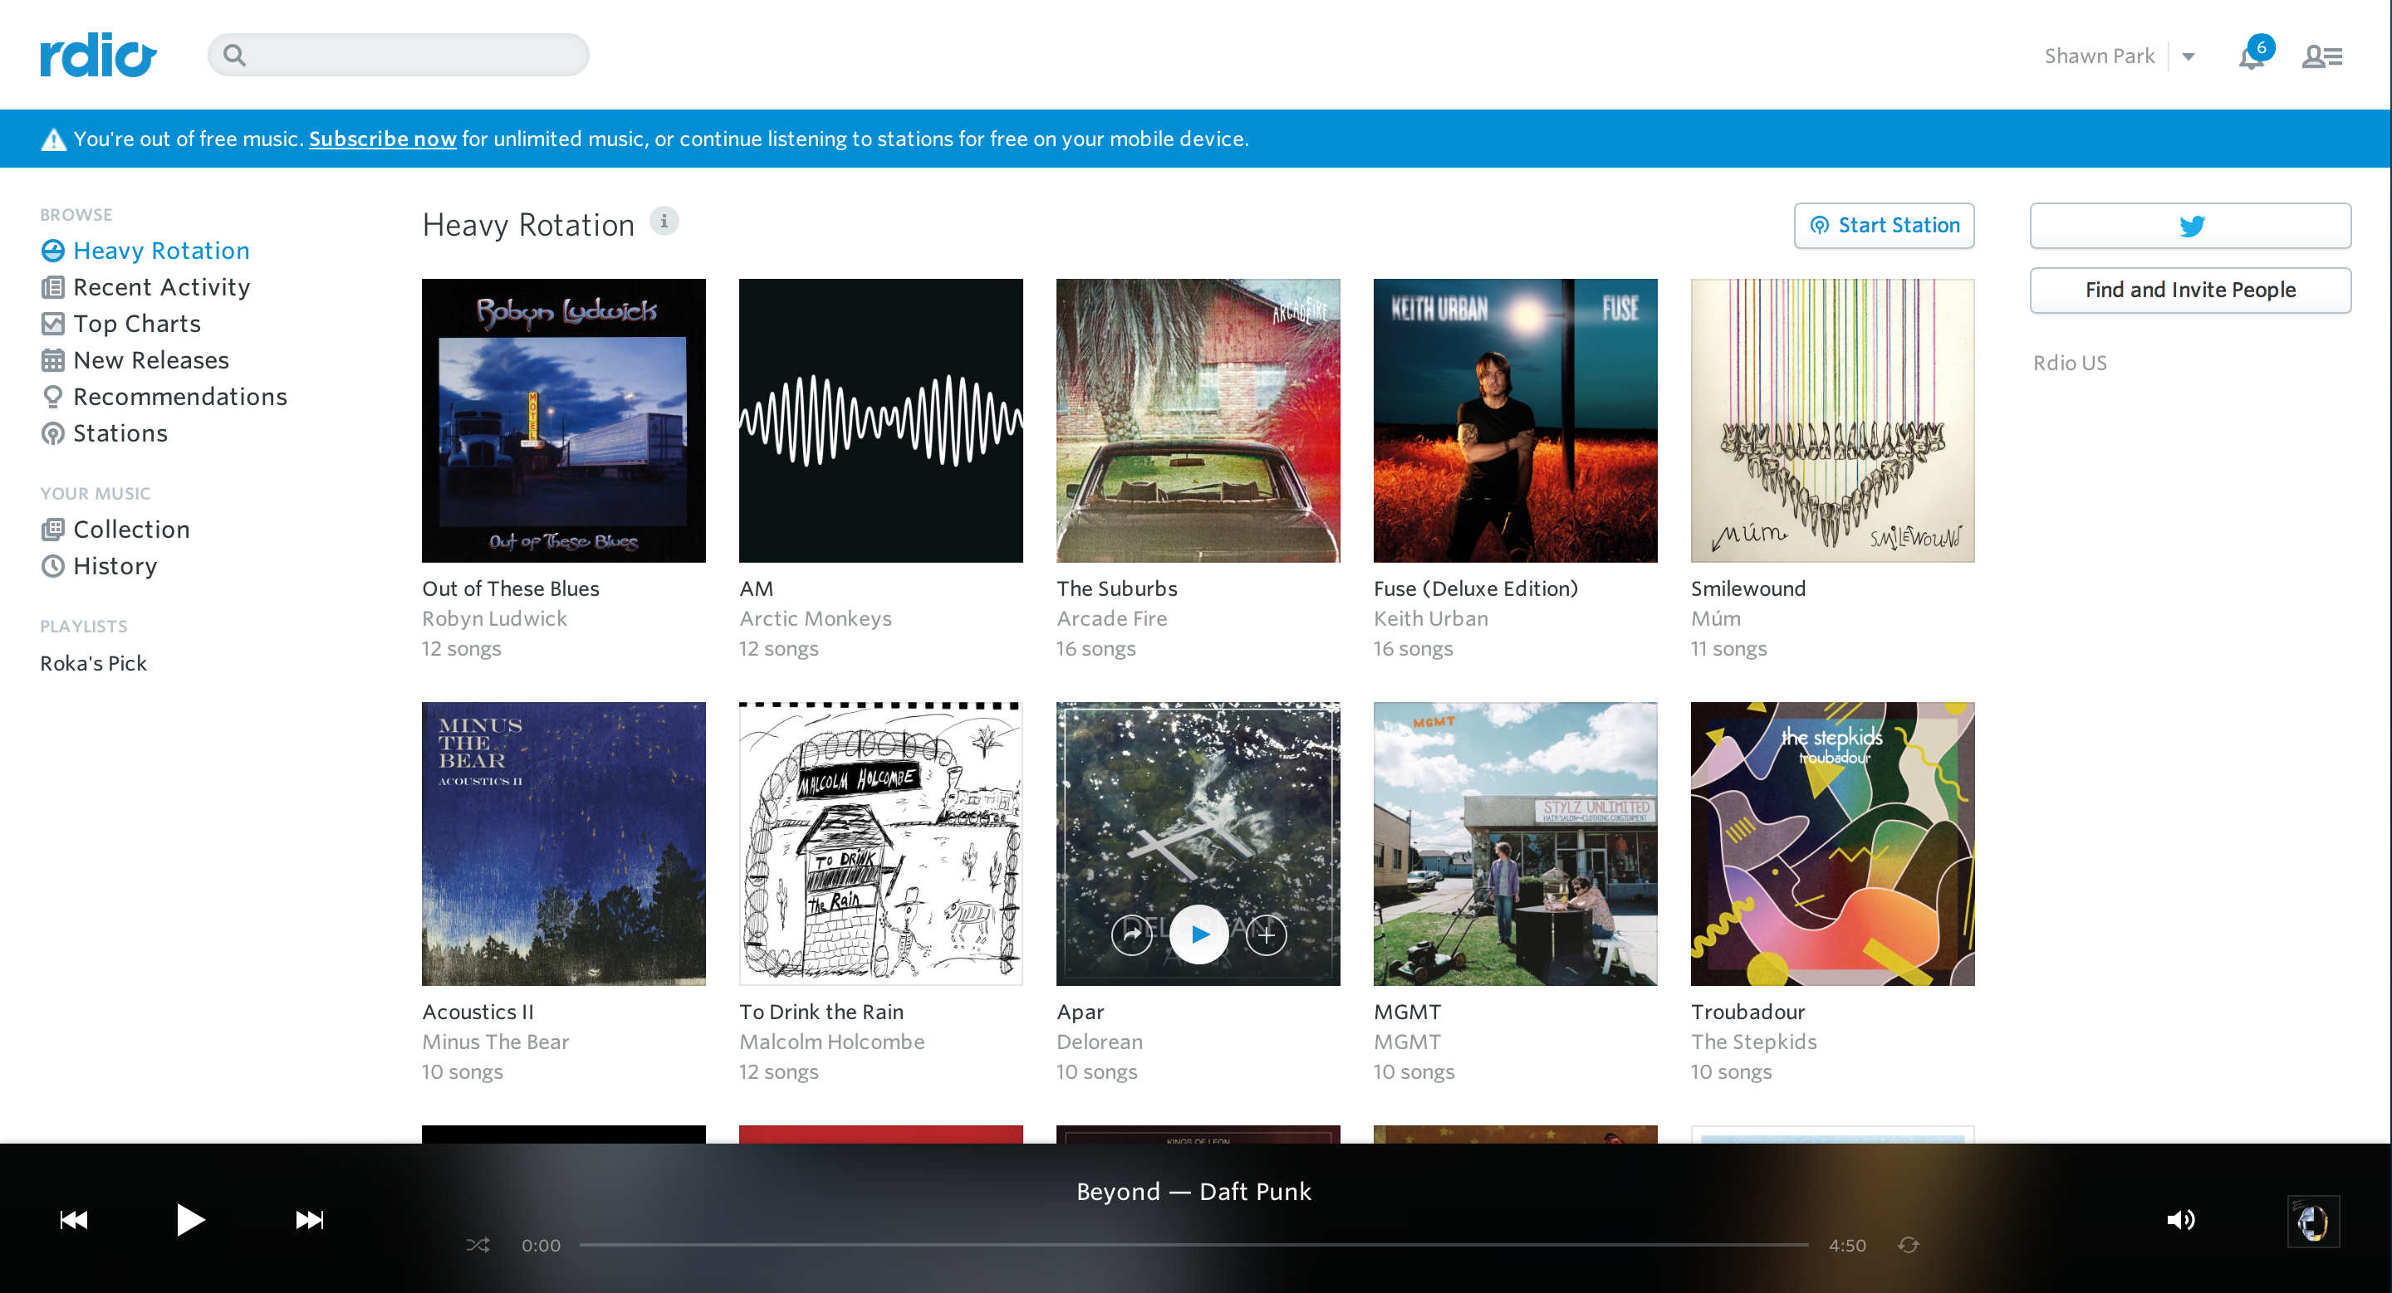
Lack of screen estate for content: rdio

Slide 21
3. Law of Threes
When you have a list, try to make three items
Example:
Facebook Charms
Windows Charms
Thumbnails (Three columns maybe?)
However, do NOT force three items
Example: Don’t make three sections “Buy” “And” “Sell” because you want to force three items to a list

Slide 22
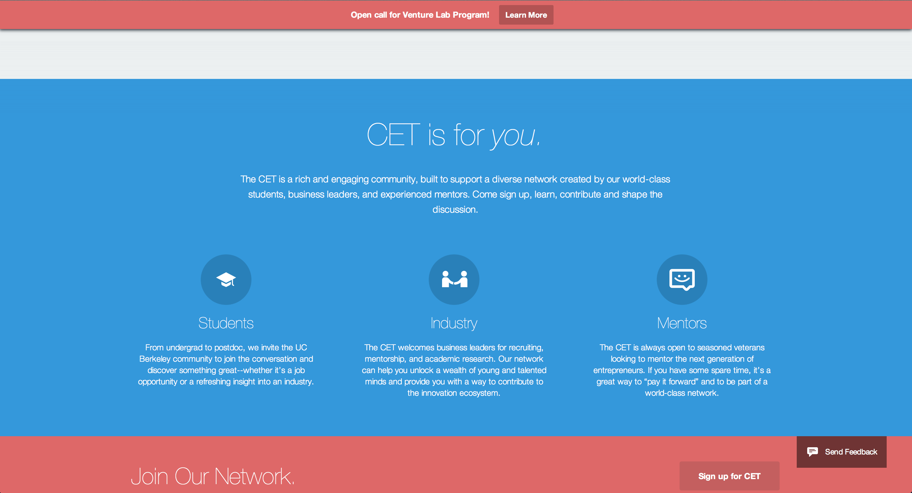
Law of Threes: CET

Slide 23
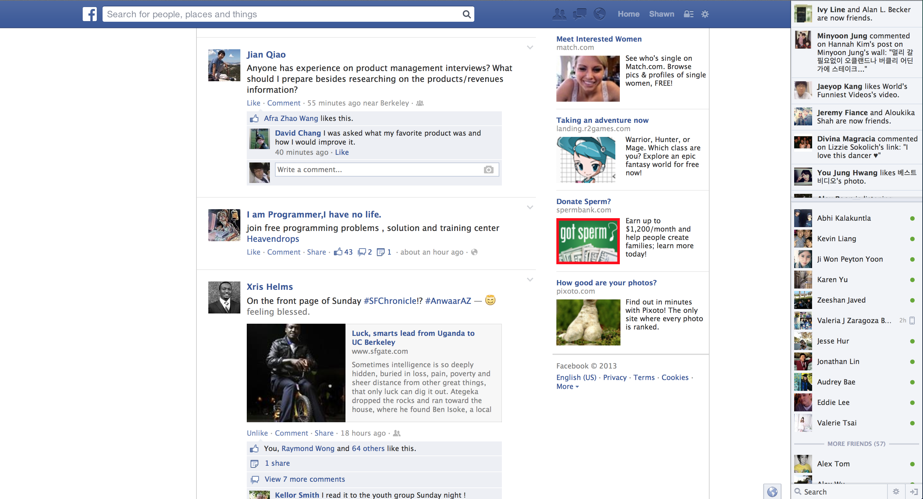
Law of Threes: Facebook

Slide 24
4. Be ready for users’ mistakes
Provide users with a some sort of a way to go back to a previous step/view in case of a mistake.
Example:
Cancel button for forms
Going back to the list after viewing an item
Close button for modal boxes

Slide 25
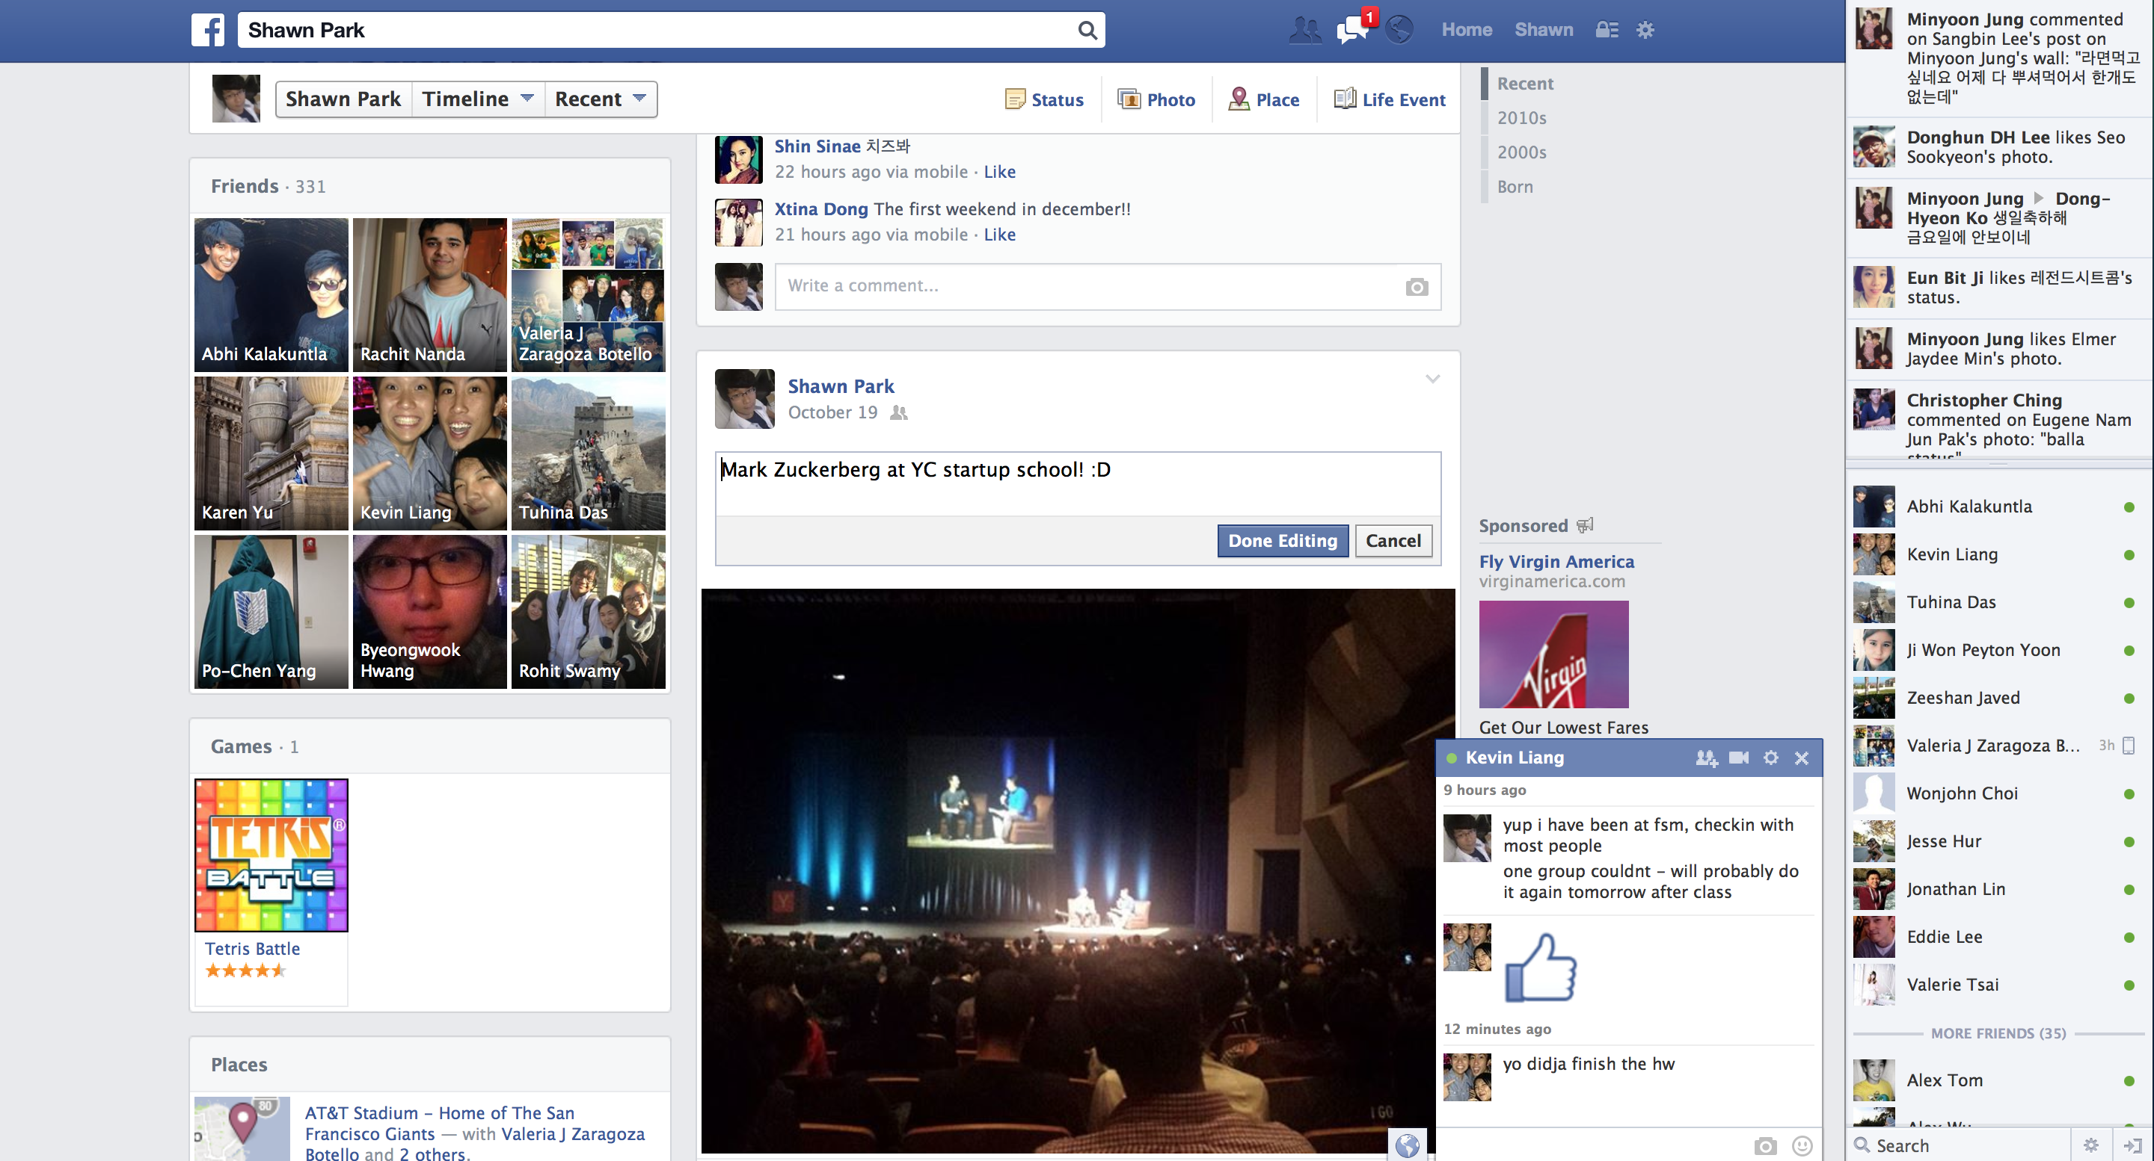
Handling User Errors: Facebook Timeline Edit Post

Slide 26
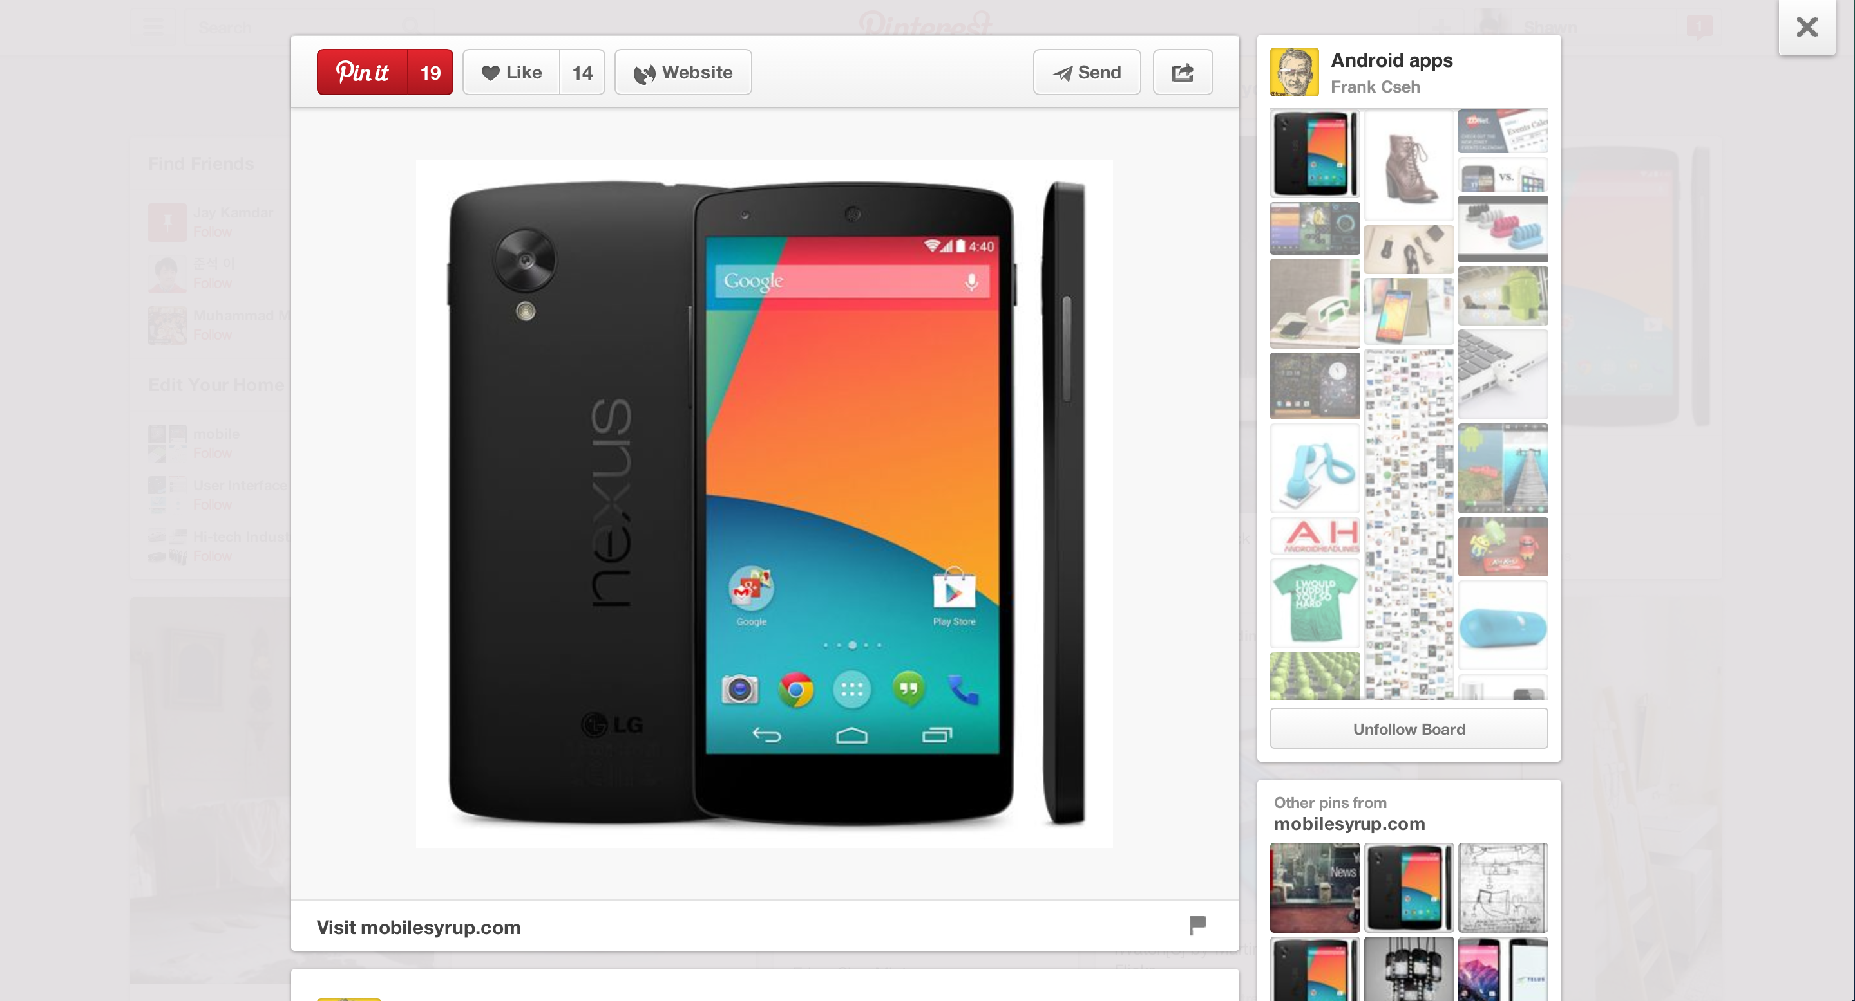
Handling User Errors: Pinterest Modal Close

Slide 27
5. Less is Good
Sometimes presenting too much information in one page can be bad
By one page, I mean “one screen area”
This is one of the most common reasons why a UI becomes “cluttered”
Space out your designs – use padding/margin and good enough font-size
Hide elements where possible/necessary
Modals
Dropdown menu

Slide 28
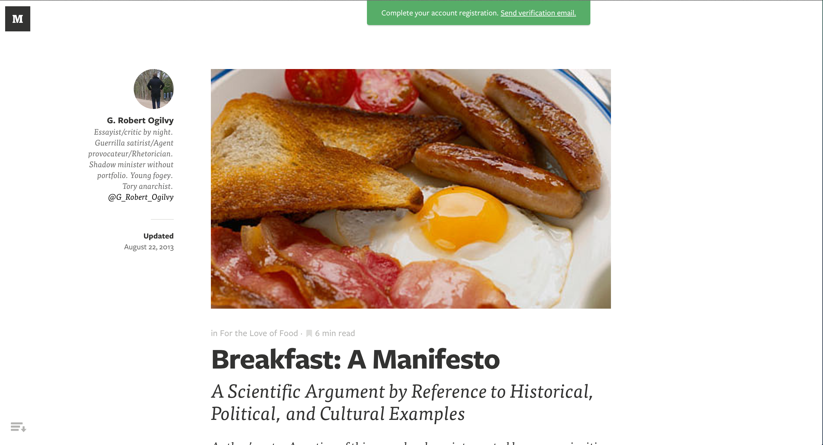
Hide Unnecessary Items: Medium

Slide 29
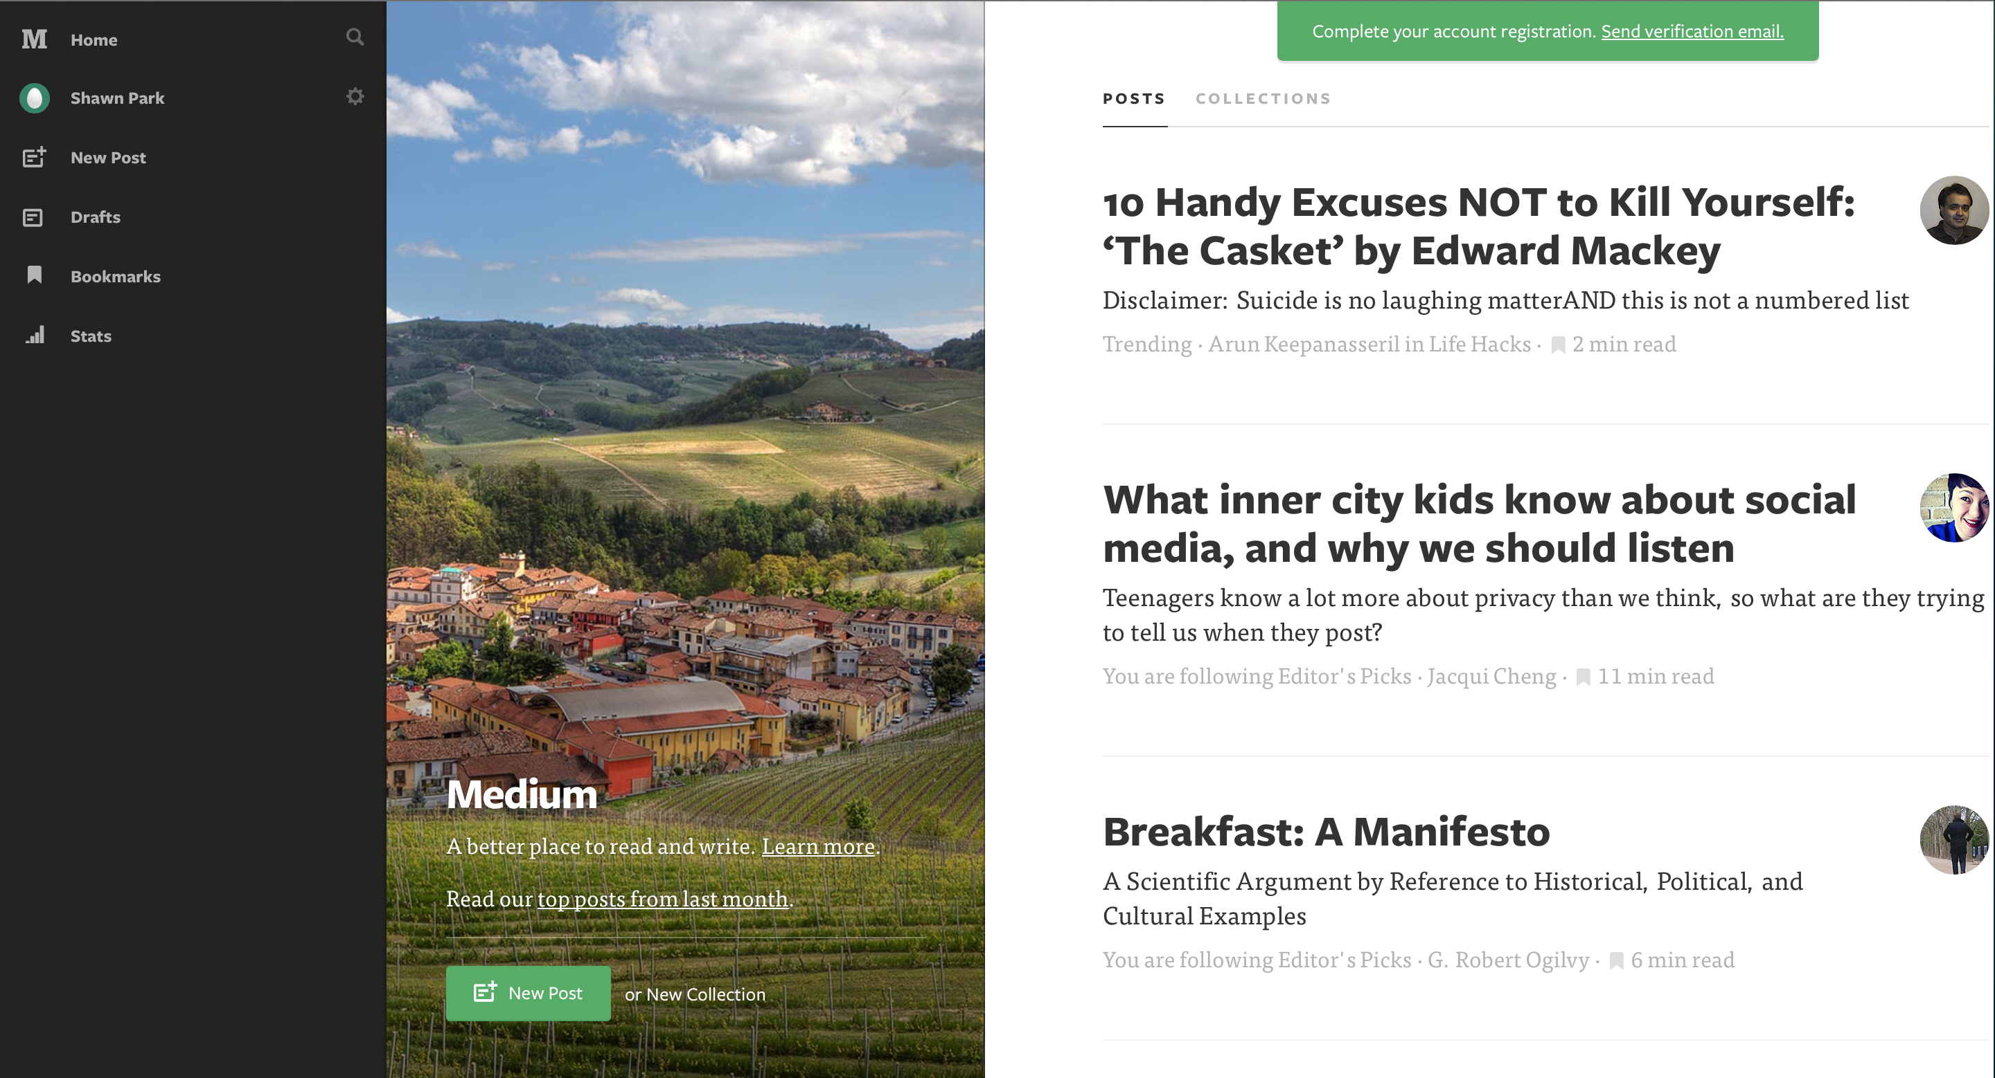
Hide Unnecessary Items: Medium

Slide 30

Hide Unnecessary Items: Google Drive

Slide 31
6. Design for Performance
Animations are not mandatory – they are only supplementary
Having too much animations and intricate behaviors might slow down the performance
Always test on all browsers and as many devices as possible
Ex.: Certain animations might be smooth on Chrome but very laggy on other browsers
Images: Keep the size low & use the right format (JPG, PNG, etc.)

Slide 32
6. Design for Performance
Demo: Chrome vs. Safari

Slide 33
7. Clicks are costly
Minimize the number of clicks a user needs to make
You want to minimize the amount of effort a user needs to make in order to execute a task
Example: Registration flow
Anything more than three steps will exhaust the user & will lead to a drop off.

Slide 34
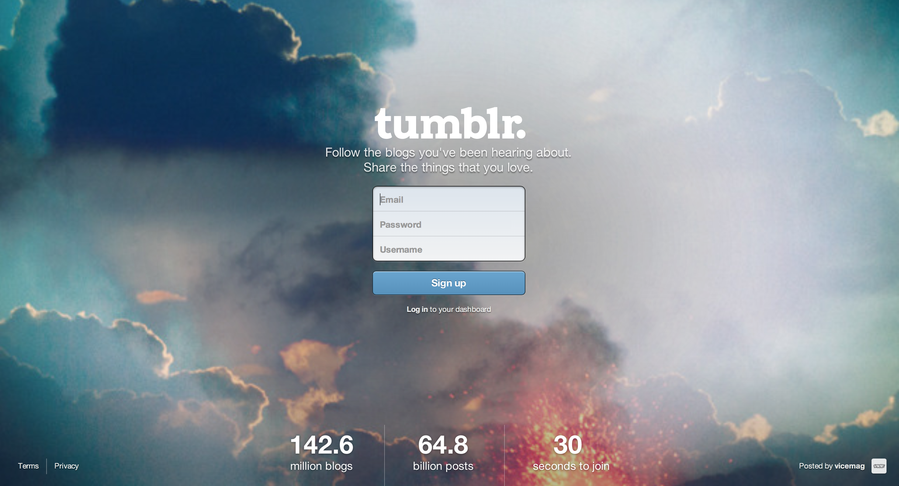
Minimal Registration Flow: Tumblr

Slide 35

Minimal Registration Flow: Tumblr

Slide 36
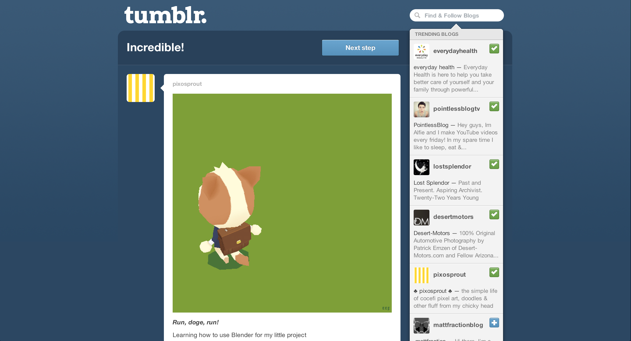
Minimal Registration Flow: Tumblr

Slide 37
8. TEST IT
You cannot guesstimate user experience – You need to observe actual user’s behavior in order to gauge user experience
What should I make my font-size? 12px?
Nobody knows except the users – make it, ship it, test it.
Test your interface in phases:
Low-fi stage (Sketches)
Hi-fi stage (HTML/CSS)
Product stage (HTML/CSS + JS)
Do A/B Testing among users to test which interface works better

Slide 38
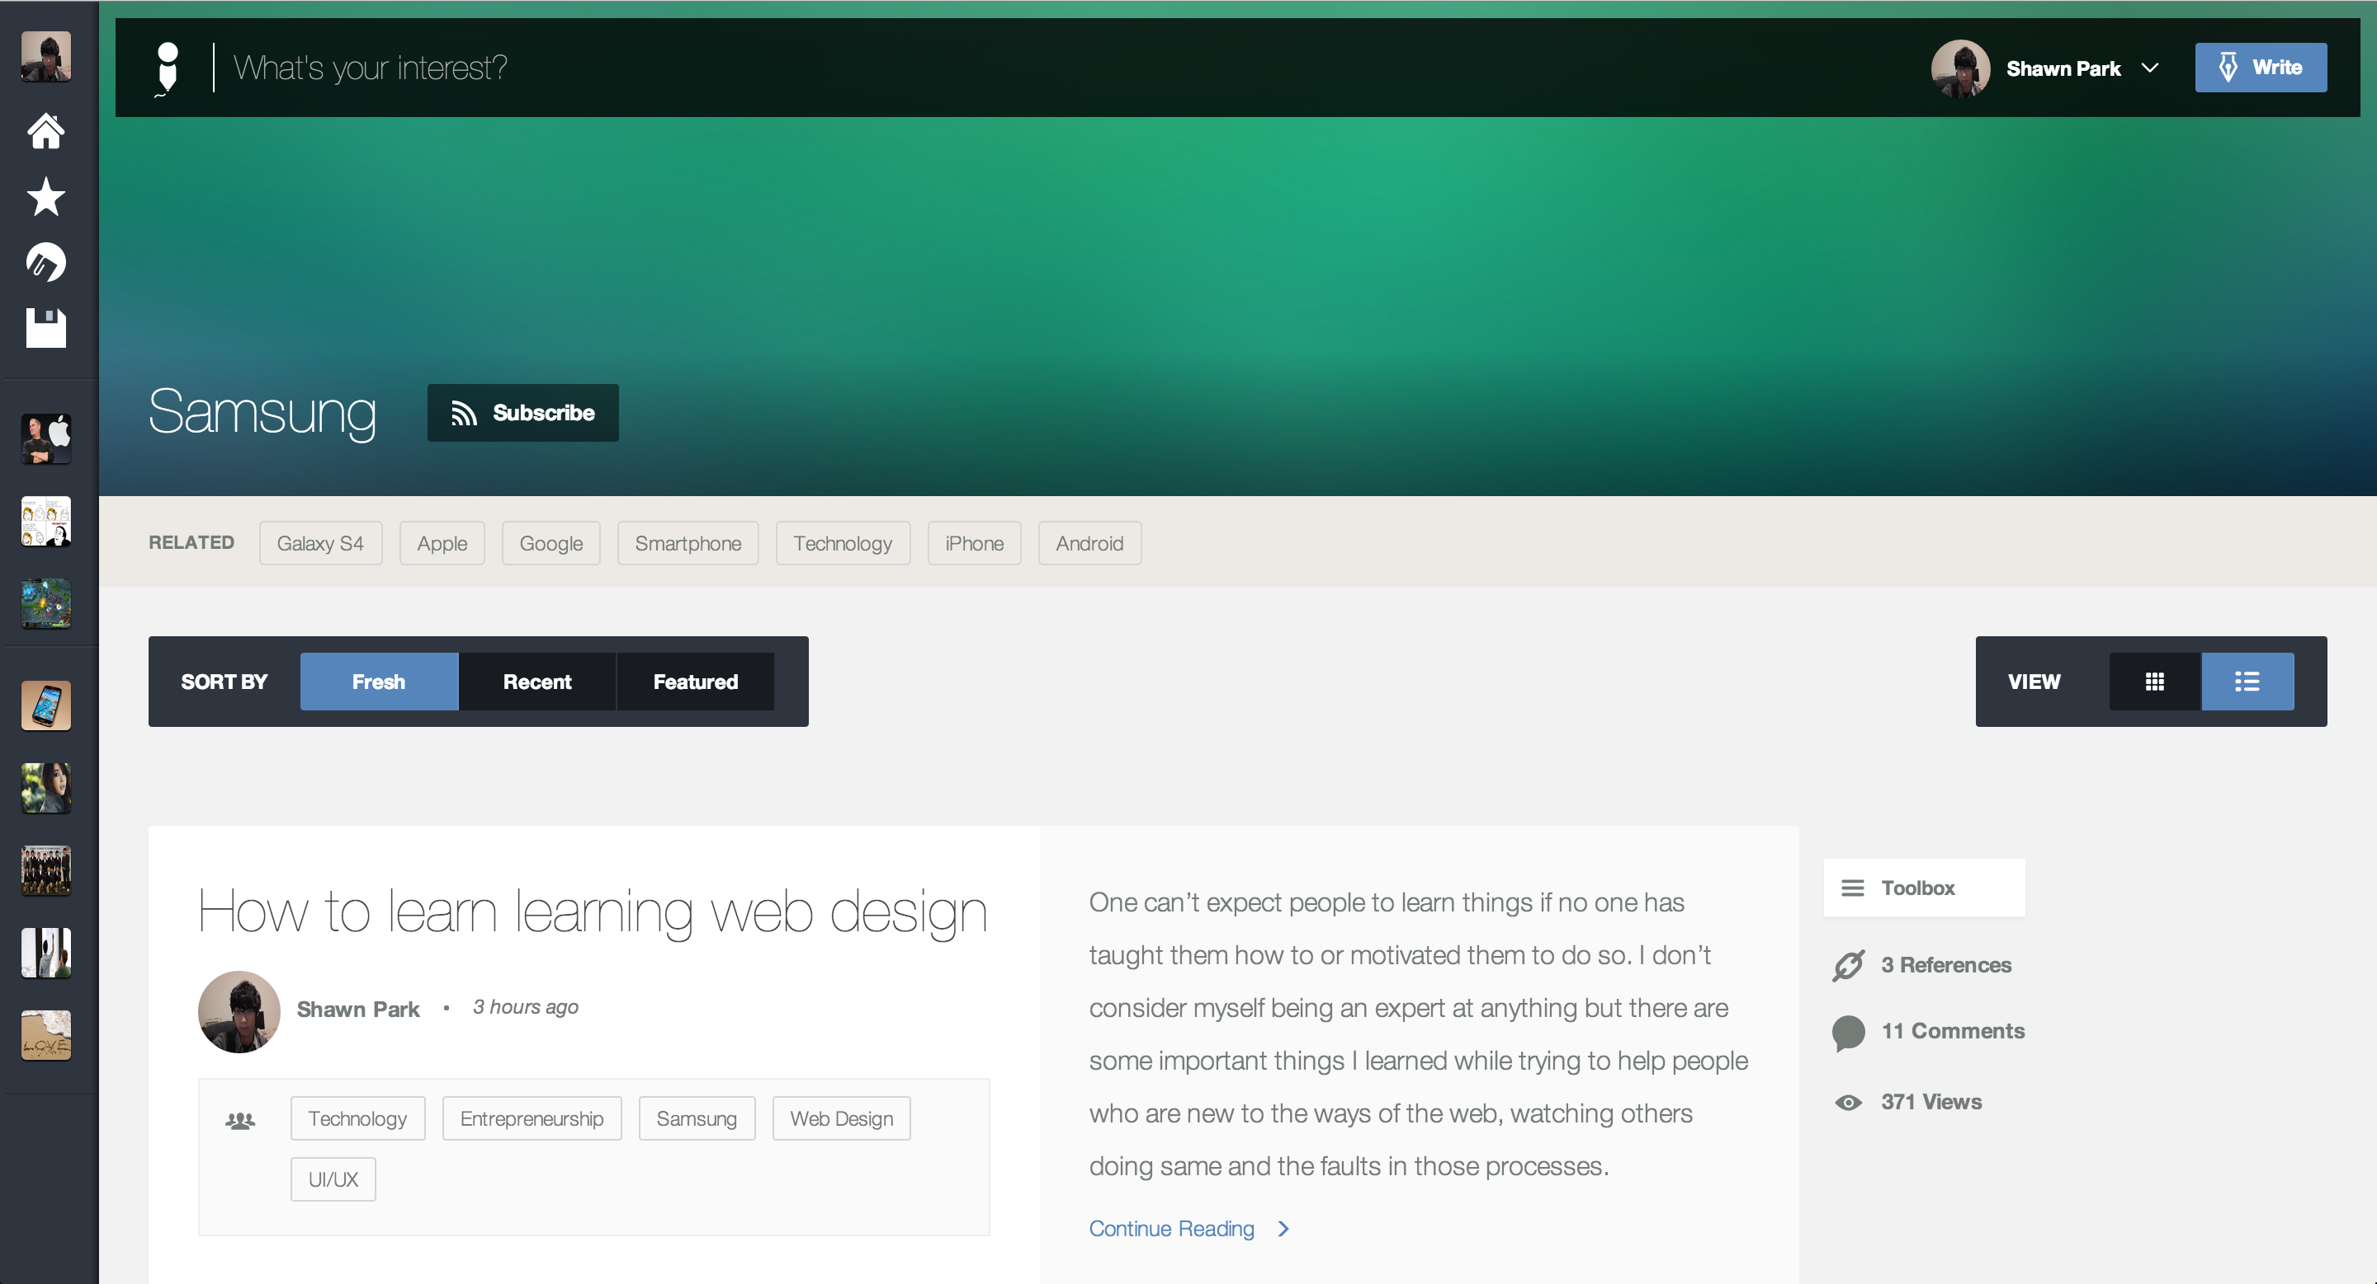
A/B Testing: Ego (Listview)

Slide 39
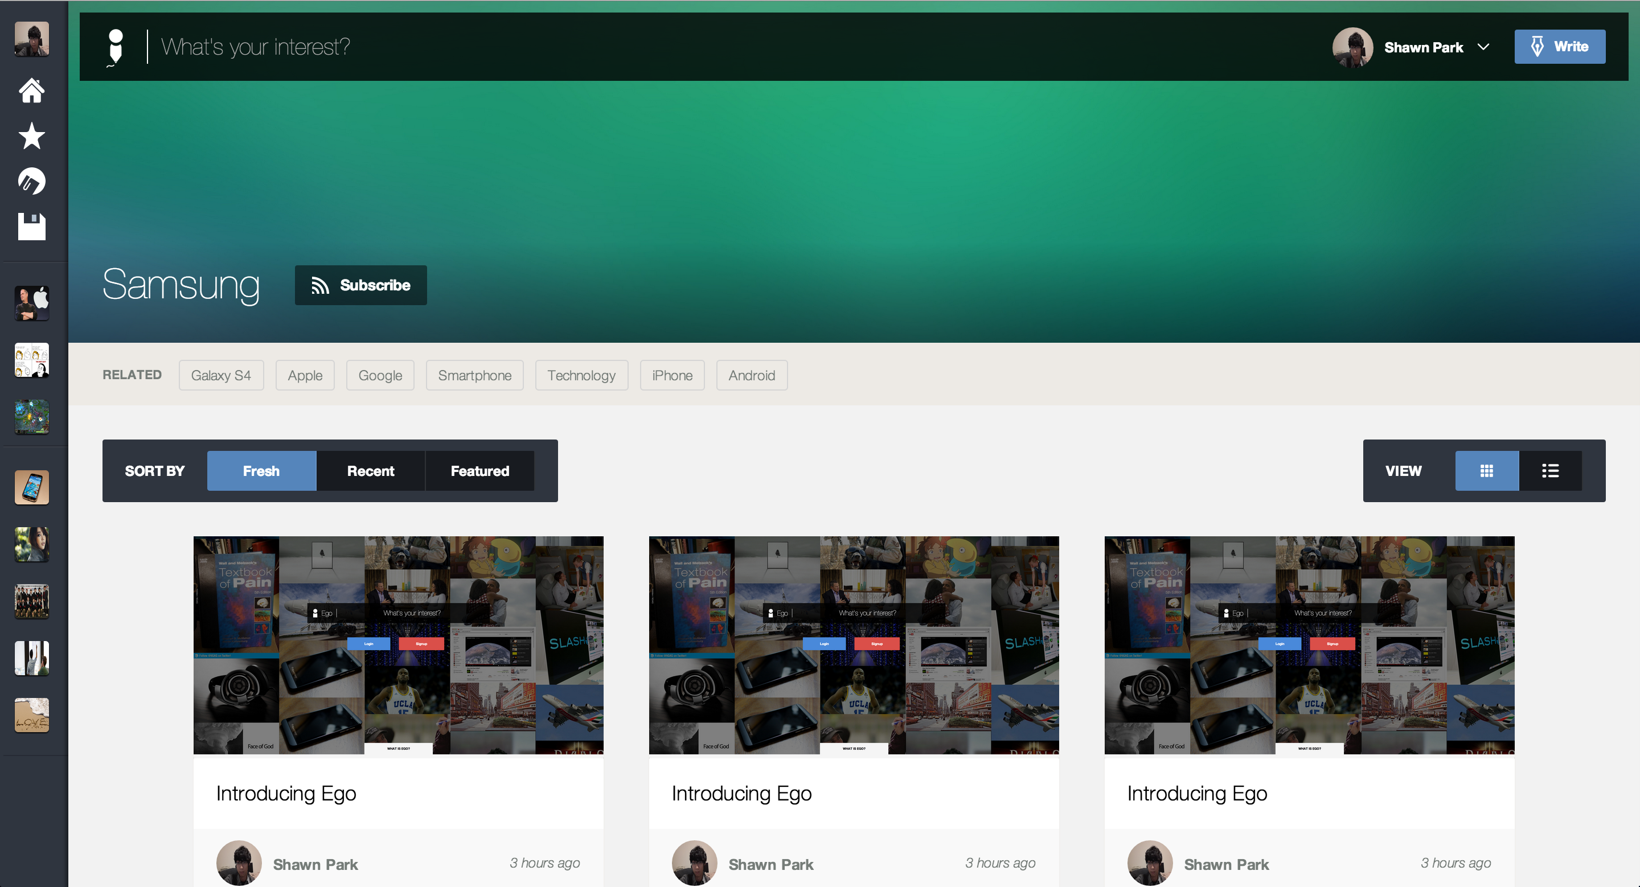
A/B Testing: Ego (Gridview)

Slide 40
Recap
1. Keep things consistent
2. Content is the king
3. Law of Threes
4. Be ready for users’ mistakes
5. Less is Good
6. Design for Performance
7. Clicks are costly
8. TEST IT

